Slide 1
Las Vegas Visualizations
File created on: 7/25/2019 10:34:20 PM

Slide 2
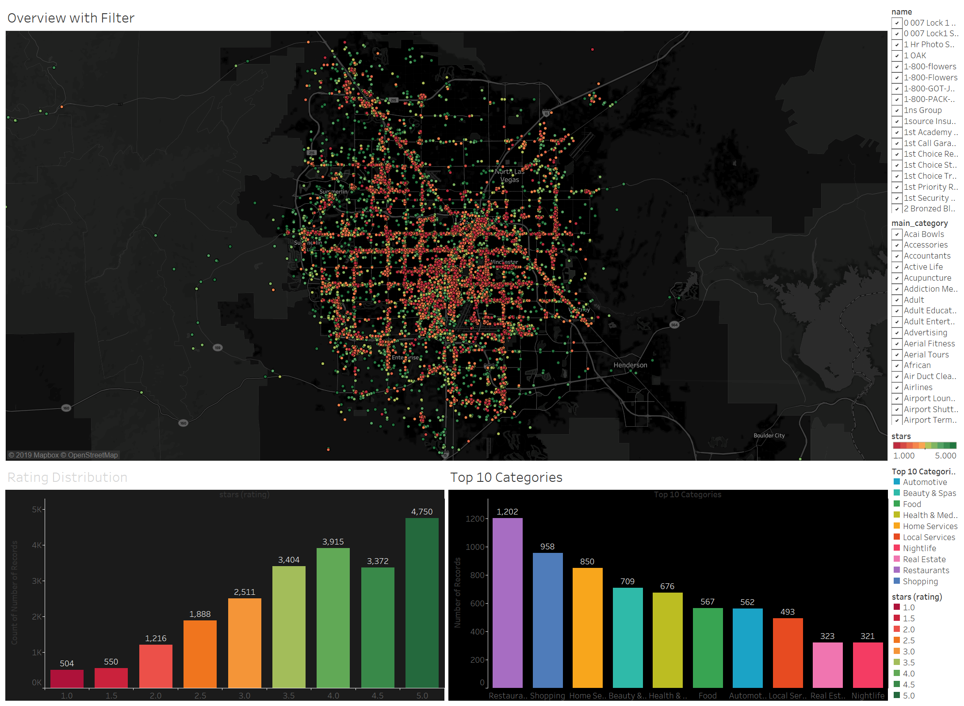

Slide 3
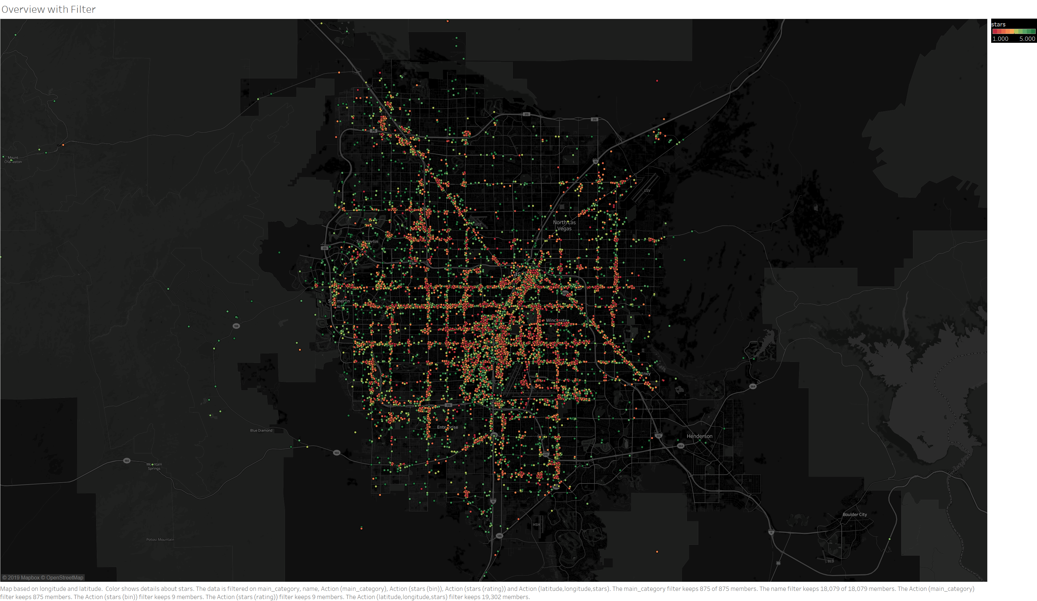

Slide 4
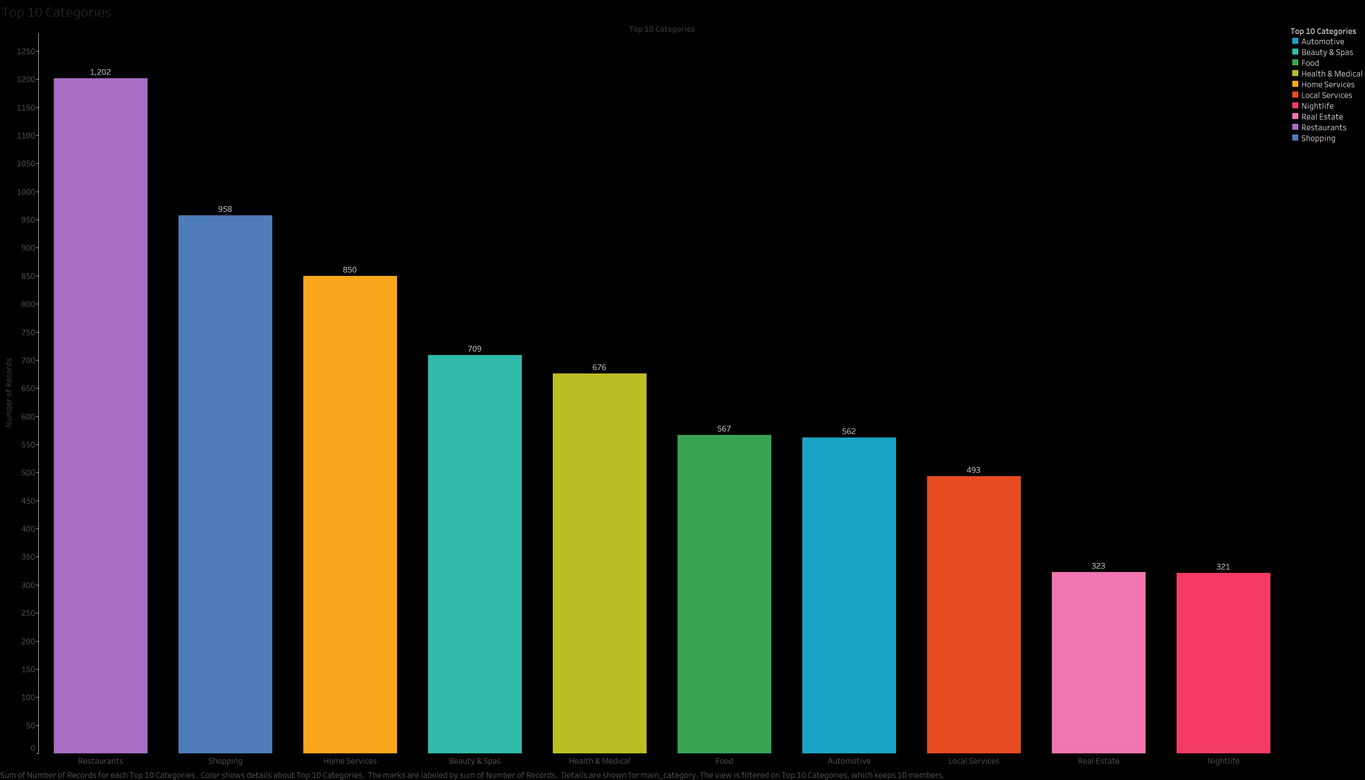

Slide 5
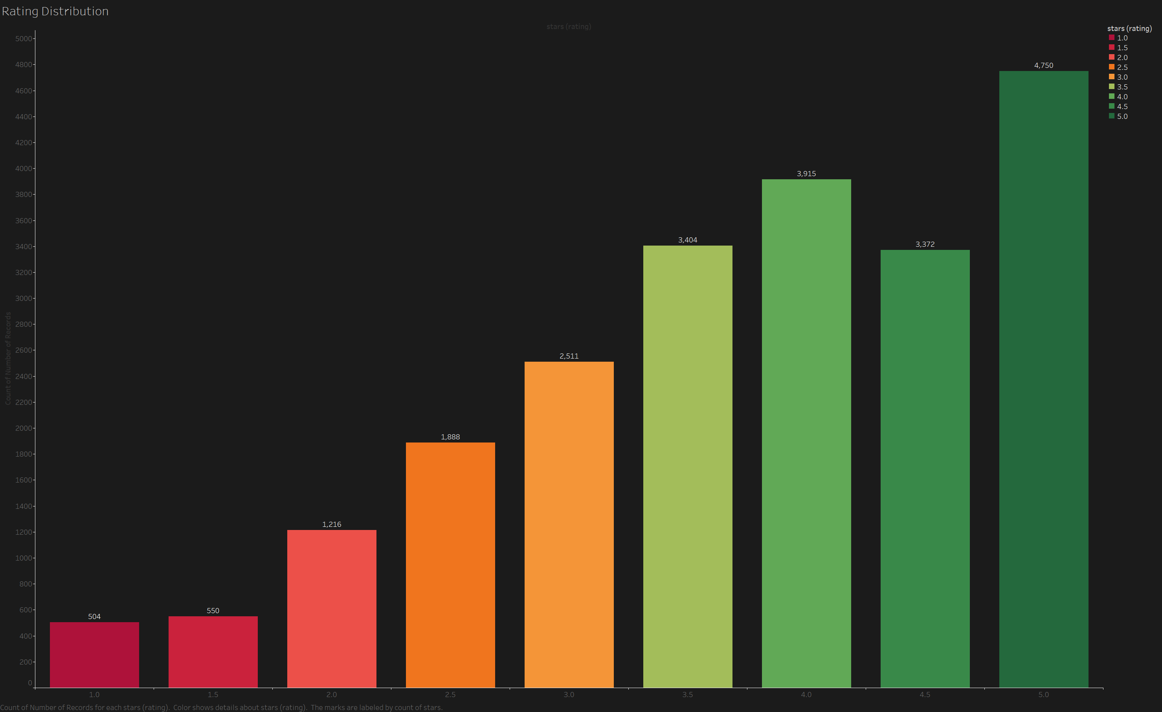

Slide 6
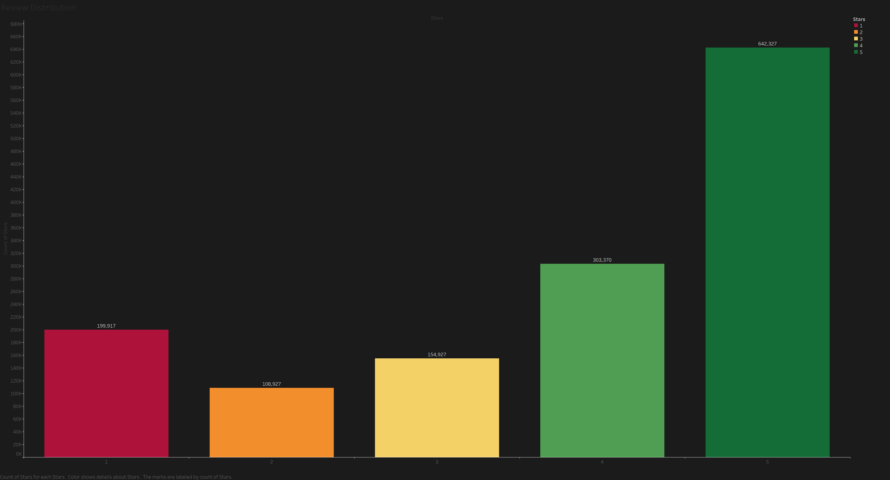

Slide 7


Slide 8
